Slide 1
Overview of the Institute for a Sustainable Future
Notes:
Leaders: feel free to use slides as is or adapt and integrate into your presentation

Slide 2
Mission Statement
Purdue University’s Institute for a Sustainable Future fosters and promotes research, partnerships, and engagement in areas including the environment, climate impacts and resilience, food-energy-water security, human and biosphere health, and sustainability as broadly defined by the UN Sustainable Development Goals. The complex, multi-factor, and pressing nature of the challenges and opportunities in these areas require a collaborative, transdisciplinary approach. This Institute supports the research and development needed to provide viable solutions by connecting faculty and researchers, and by forging linkages between disciplines and communities within Purdue and beyond. In this way, the Institute aligns with Purdue’s Land Grant Mission of building human capital, advancing research focused on our world’s most important problems and engaging deeply with our partners.

Slide 3
UN Sustainable Development Goals

Slide 4
ISF Vision
Be the focal point within Purdue for research projects involving large, complex, transdisciplinary efforts in the environment, climate, food security-energy-water security, building resilience, and sustainability, among other topics;
Actively support the development and implementation of innovative team projects;
Help administer relevant University programs in these areas involving a variety of grants, fellowships, programs, and opportunities;
Support the growth and integration of large, sustained research efforts and partnerships from basic research, through applied and use-inspired research to commercialization;
Foster the co-production and co-creation of new knowledge and solutions suitable for use;
Support the professional and research training necessary to develop the next generation of scientific leadership in these critical areas;
Support engagement at all levels to provide a strong, science-based grounding for ongoing efforts these areas.

Slide 5
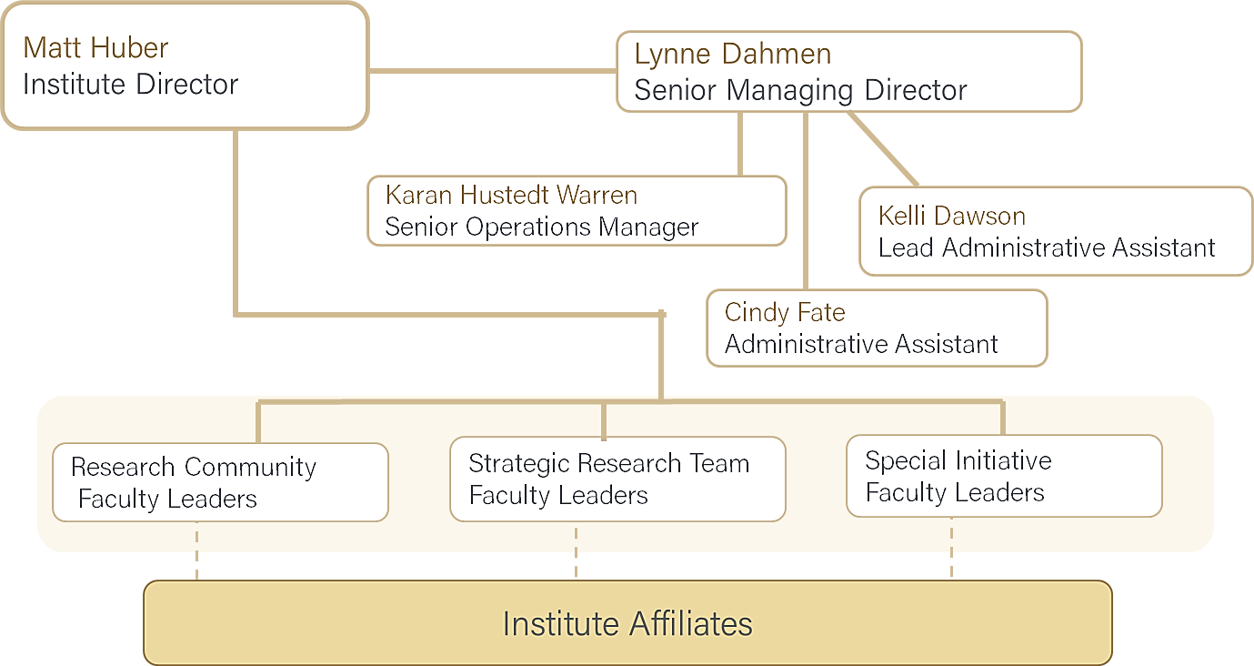
ISF Organizational Structure
External Advisory Board
Internal Advisory Board
Leadership Team

Slide 6
Communities, Initiatives, and Leaders
 | Leadership |  | Leadership
Biodiversity | Jingjing Liang (FNR), Ximena Bernal (BIO) | Climate and Weather | Lei Wang (EAPS)
Environmental Justice | Ellen Wells (HSCI), Aaron Thompson (HORTLA) | Great Lakes Science Initiative | Tomas Höök (FNR), Cary Troy (CE)
Environmental Stressors | Jonathan Shannahan (HSCI), Jason Hoverman (FNR) | Risk and Resilience | David R. Johnson (IE, POL)
Sustainable Communities | Recruiting new leads! | Imagining Sustainable Futures | Bob Marzec (ENGL)
Water Challenges | Keith Cherkauer (ABE), Lisa Welp (EAPS)

Slide 7
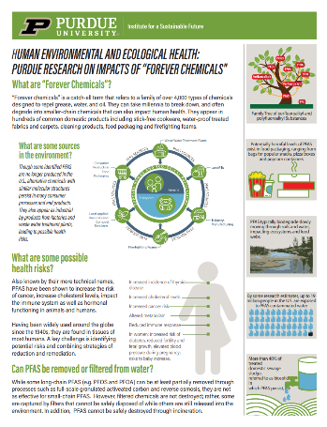
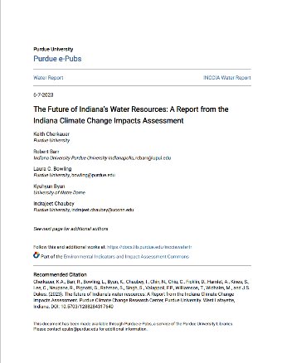
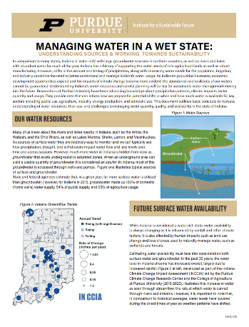
SRTs and Supported Projects
PFAS projects
NIH P42 project
NSF RIE project
Industrial Efficiency and Decarbonization
DOE
White papers
PFAS
Water management
Indiana Climate Change Impact Assessment

Slide 8
Types of support provided to affiliates
Opportunity identification, Teaming and Proposal Development
Leadership & professional development
Research teaming and potential infrastructure
Administration of grants and fellowships
Event planning and support
Supporting travel for development and presentations

Slide 9
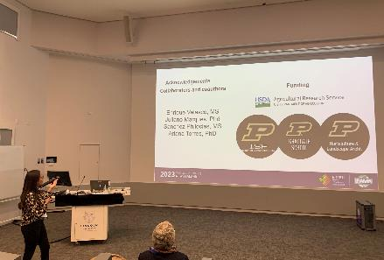
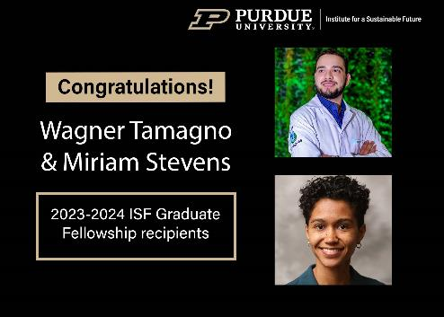
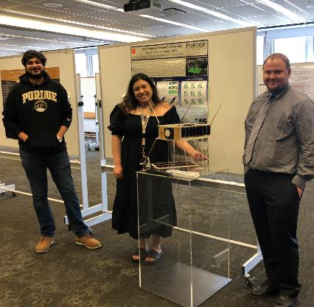
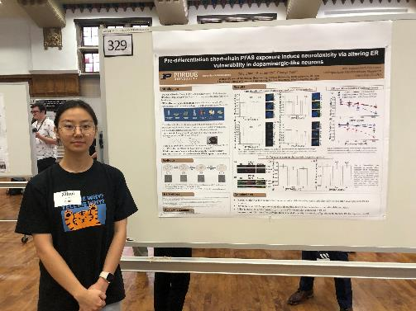
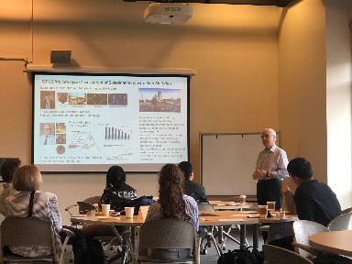
Student Support
Travel/Research Grants
Training Opportunities
Graduate Fellowships
Research Expo
Undergraduate Fellows

Slide 10
Key ISF Strengths
Effective, experienced teams in:
Data-driven, systems modeling and risk analysis
Environmental stressors and health impacts
Internet of things, remote and in situ sensing ag/ecosystems
State-to-national water challenges
Environmental justice and social science perspectives
Climate, food, energy, water security modeling
Signature approach “global->local->global” analysis for systems stability
Circular economy & decarbonization, renewable energies

Slide 11
Faculty Affiliate breakdown by college
N= 289

Slide 12
Key External Partners & Funding Sources
Organizations
IDEM
Environmental Research Institute (IU)
Hoosier Environmental Council
White River Alliance
IN DNR
Earth Justice IN
New Carbon Economy Consortium
Midwest Regional Climate Consortium
Purdue University –NW
University of Notre Dame
Butler University
Sandia National Laboratories
JPL
IL-IN Sea Grant
Key Funders
NSF
NIH
USDA
Dept. of Defense
Dept. of Energy
SERD-P
NASA
NOAA
Dept. of the Interior
USGS
USAID

Slide 13
PRIORITIES & GOALS FOR FY24
Research
ISF Growth
Revenue streams
Support PFAS Strategic Research Team to submit NIH P42 center grant & other possible large opportunities (e.g. EPA)
Work with faculty to respond to interdisciplinary RFPs related to IRA, Infrastructure and CHIPS Acts from multiple agencies with emphasis on growth in DOE, NASA, NOAA, DHS, USAID and sustaining strengths at NSF, NIH, EPA, USDA
Growing corporate and NGO partnerships
Respond to above opportunities with external partners and stakeholders
Develop & support additional Research Communities (RCs), Special Initiatives (SIs) and Strategic Research Teams (SRTs) working towards goal of ~7RCs, ~5 SIs, 2 SRTs
Develop internal & external advisory boards
Increase engagement with external organizations, universities and government stakeholders
Grow involvement of graduate students, post-docs and early-career researchers
Continue to offer professional development opportunities for faculty, staff and students
Work with faculty to include more administrative and soft-money research roles for large projects within the Institute
Corporate partnerships
Pursue more joint opportunities to fund research and outreach with other colleges, institutes and centers
Increase visibility with the many large philanthropic organizations and high-value individuals operate in the sustainability space.

Slide 14
Please join us for the annual ISF research expo + reception on 10/25 from 1:00-5:00p in the PMU South ballroom.
More information about these events, and others, is available on our website: research.purdue.edu/isf/

